Slide 1
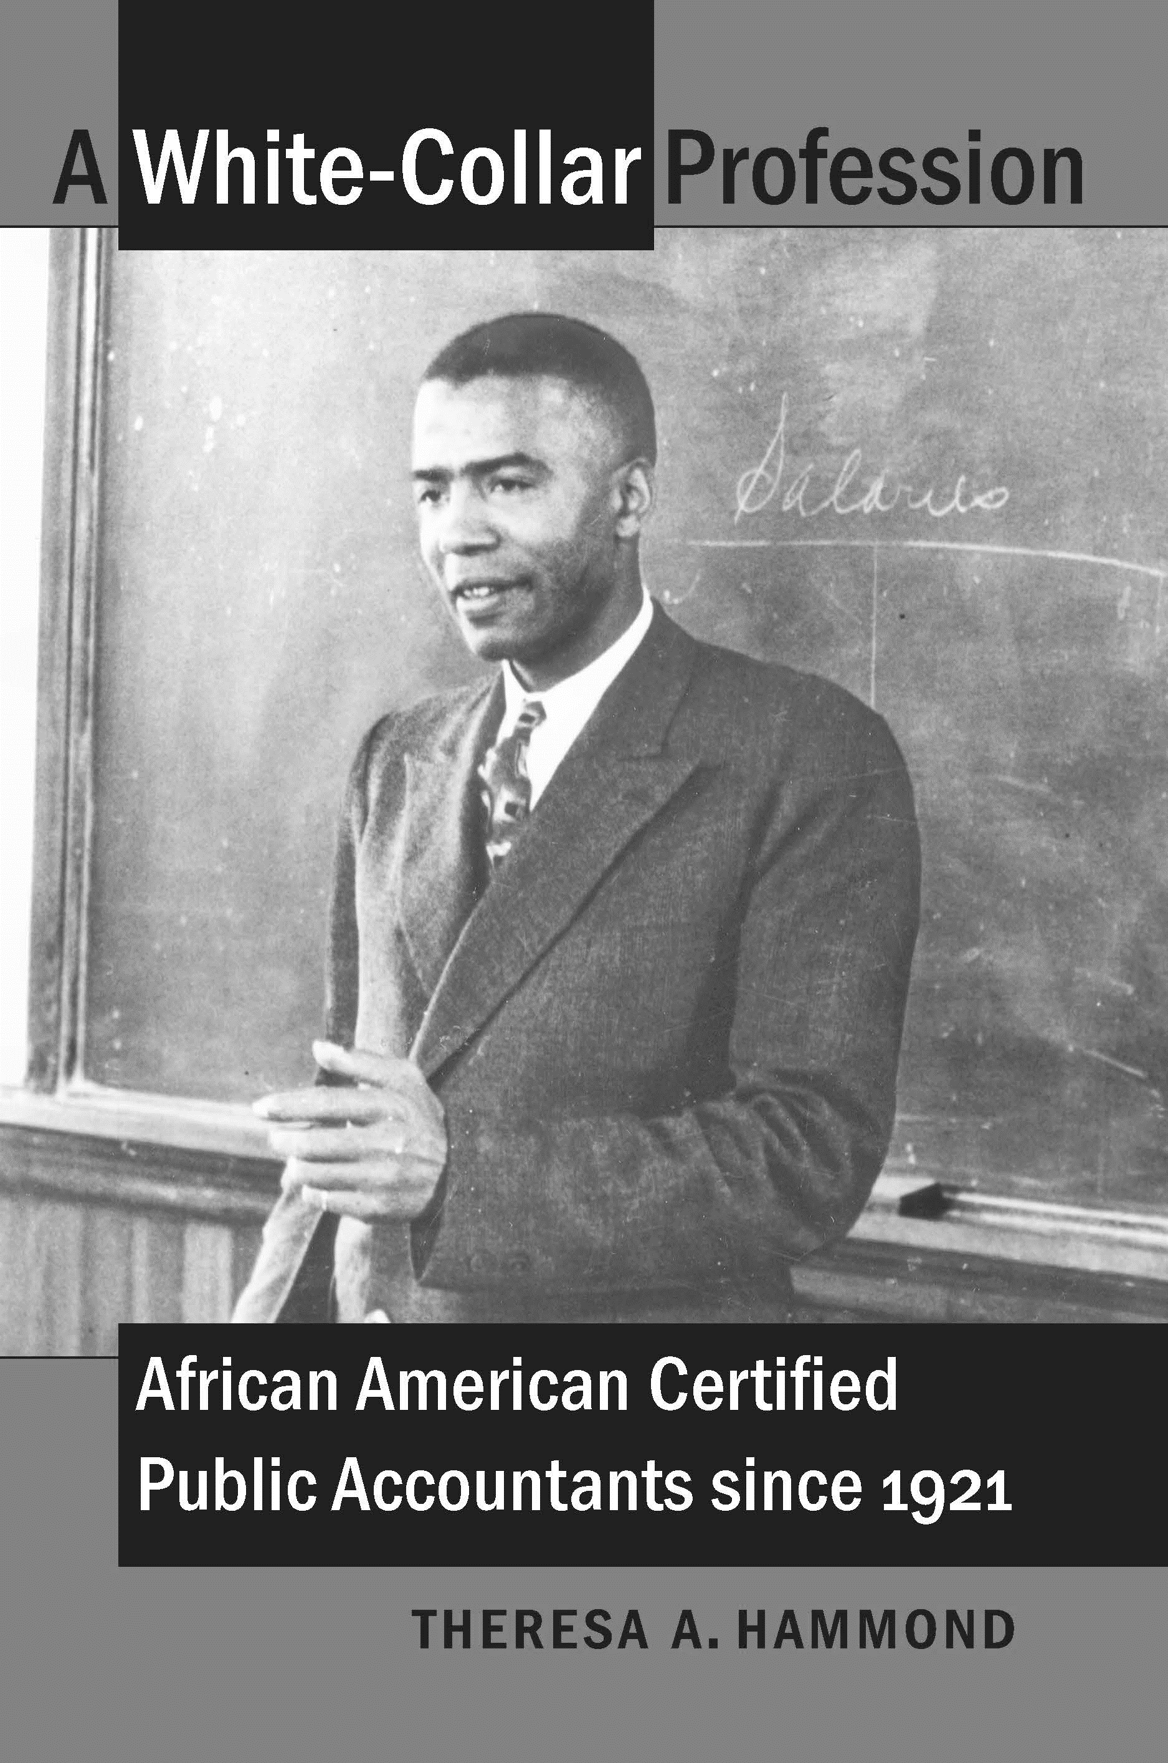
Celebrating the 100th Anniversary of the First Black CPA
AAA DEI
Black History Month 2021

Slide 2
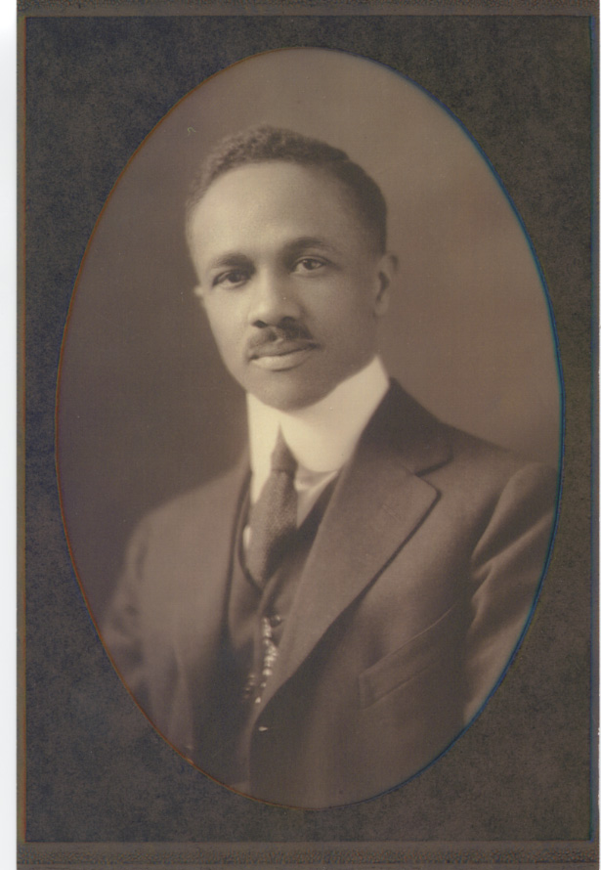
John W. Cromwell, Jr., the first African-American CPA (New Hampshire, 1921)
Born into a prominent Washington, D.C., family, John Cromwell graduated Phi Beta Kappa from Dartmouth College in 1906. He taught math at a Black high school in D.C., and returned to New Hampshire to take the CPA examination in 1921. At that time, African Americans could not find employment with CPA firms, and New Hampshire was attractive because it did not yet have an experience requirement. Cromwell continued to teach and was later controller at Howard University. On evenings and weekends, he worked as a CPA for Black-owned businesses in the D.C. area.

Slide 3
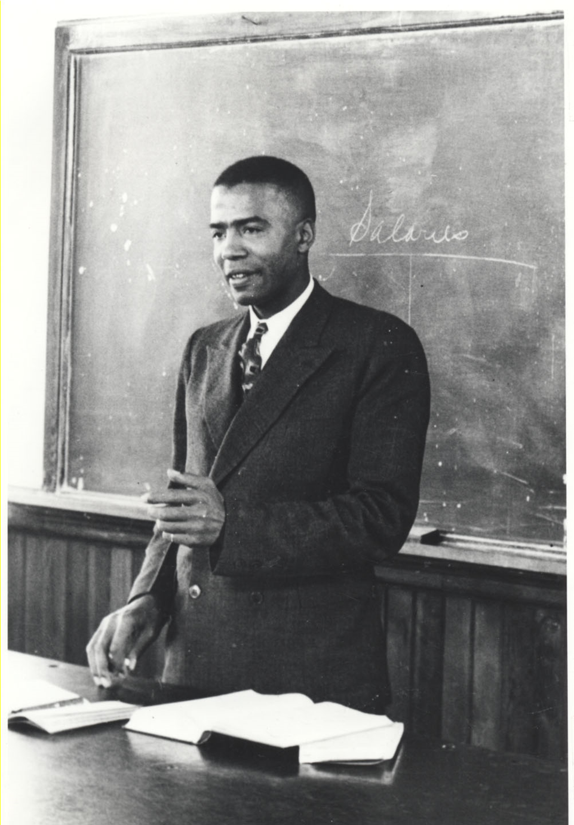
Professor Jesse B. Blayton, Georgia, 1928
Professor Jesse B. Blayton was known as the “Dean of Negro Accountants” because he encouraged and trained numerous African-American CPAs. He taught at Morehouse College and Atlanta University for decades, and consulted with cabinet members in President Franklin Roosevelt’s administration regarding the impact of New Deal programs on the Black community. In the 1960s, he and his Atlanta-based firm provided services to the Reverend Martin Luther King Jr. and to the Southern Christian Leadership Conference.

Slide 4
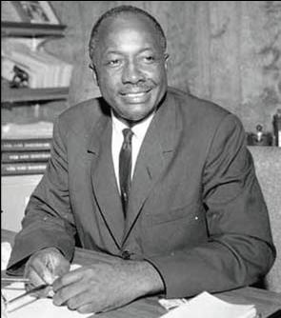
Richard Austin, Michigan, 1941
Richard Austin graduated from his large Detroit high school at the top of his class. While a teenager, he had developed a bookkeeping practice with primarily Black and Jewish clients. One of his professors helped him meet the experience requirement, and he went on to have a successful CPA firm in the city. He was elected Wayne County Auditor in 1966, narrowly lost a race that would have made him Detroit’s first Black mayor in 1969, and was elected as Michigan’s Secretary of State in 1971. Re-elected four times, he served in the role for over two decades.

Slide 5
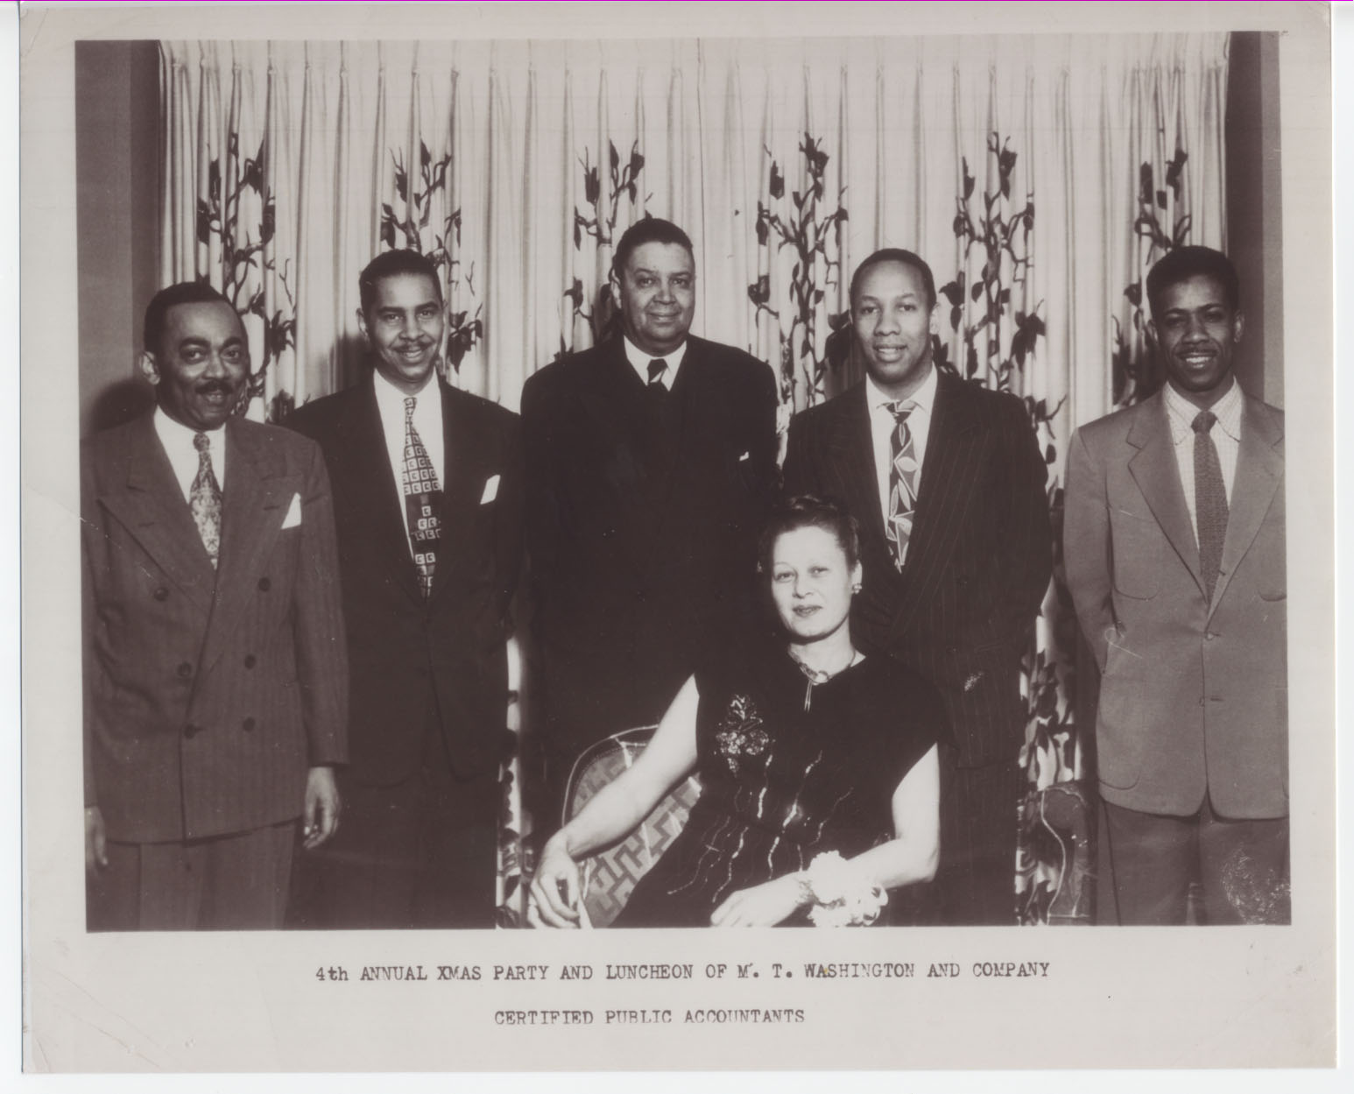
Mary T. Washington, the first African-American female CPA (Illinois, 1943)
Mary T. Washington was the founder of Washington, Pittman, and McKeever, LLC, one of the largest Black-owned CPA firms in the country. She provided the experience needed to earn a CPA to many African Americans who could not find employment elsewhere. Many aspiring CPAs moved to Chicago to work for her.

Slide 6
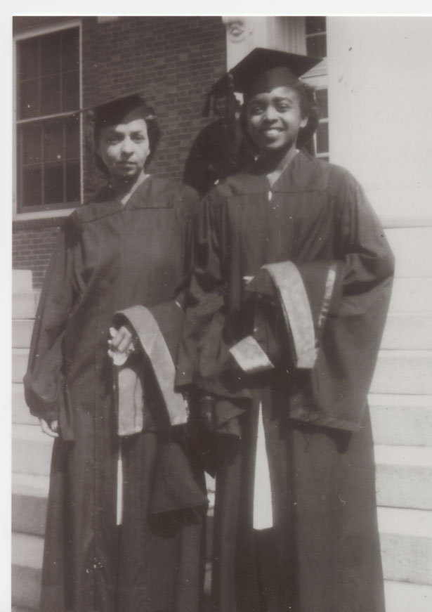
Bernadine Coles Gines (right), New York, 1954
Bernadine Coles Gines earned an MBA from New York University in 1947 and became the first African-American female CPA in New York in 1954. Barred due to her race from attending the University of Virginia, Gines had moved to New York in the hope of finding better opportunities. Nonetheless, it was difficult to find a firm to hire her. The one Black-owned firm in New York did not employ women. After years of searching, she finally found employment with a small Jewish-owned firm. She went on to work for the City of New York until she retired. Her sister, Ruth Coles Harris, became the first African-American female CPA in Virginia in 1963.

Slide 7
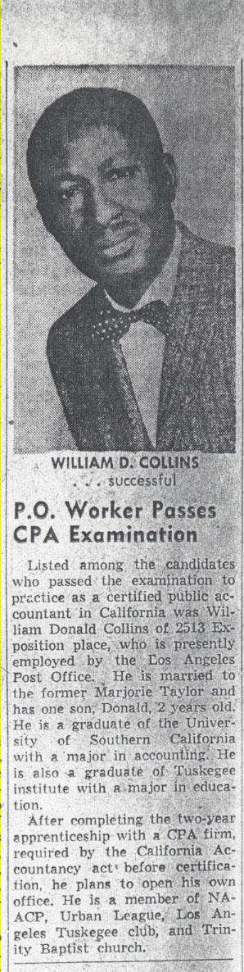
William D. Collins, California, 1959
World War II veteran William D. Collins moved to California after the war in pursuit of better opportunities. He graduated from the University of Southern California’s accounting program near the top of his class in 1954. On campus, he interviewed with many major firms, all of whom declined to hire him after discovering his race. Like many other pioneering Black CPAs, he found work with a Jewish CPA firm in order to meet the experience requirement. He then opened his own firm, and retired at the age of 91. Mr. Collins shared his story with the California Society of CPAs in 2011 https://www.youtube.com/watch?v=Kqq-_N-Iq2Q.

Slide 8
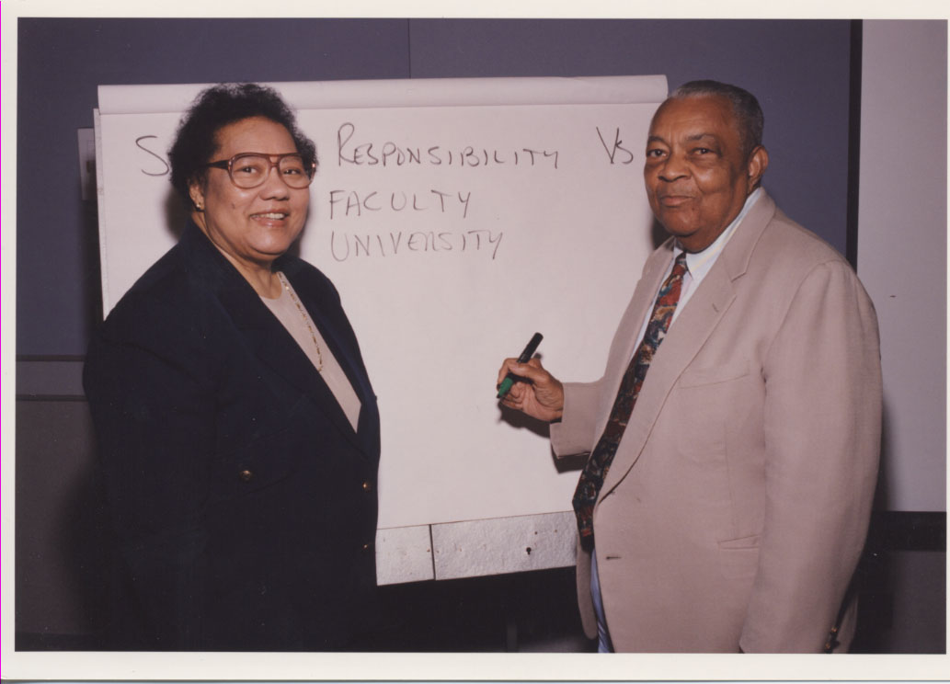
Larzette G. Hale, Georgia, 1951, and Milton Wilson, Indiana, 1951
Dr. Larzette Hale became the first African-American woman to earn a Ph.D. in accounting in 1955 (University of Wisconsin). Dr. Milton Wilson earned his Ph.D. in 1951 (Indiana University), and, as Dean, led Texas Southern University and Howard University to become the first two historically Black colleges to earn AACSB accreditation.

Slide 9
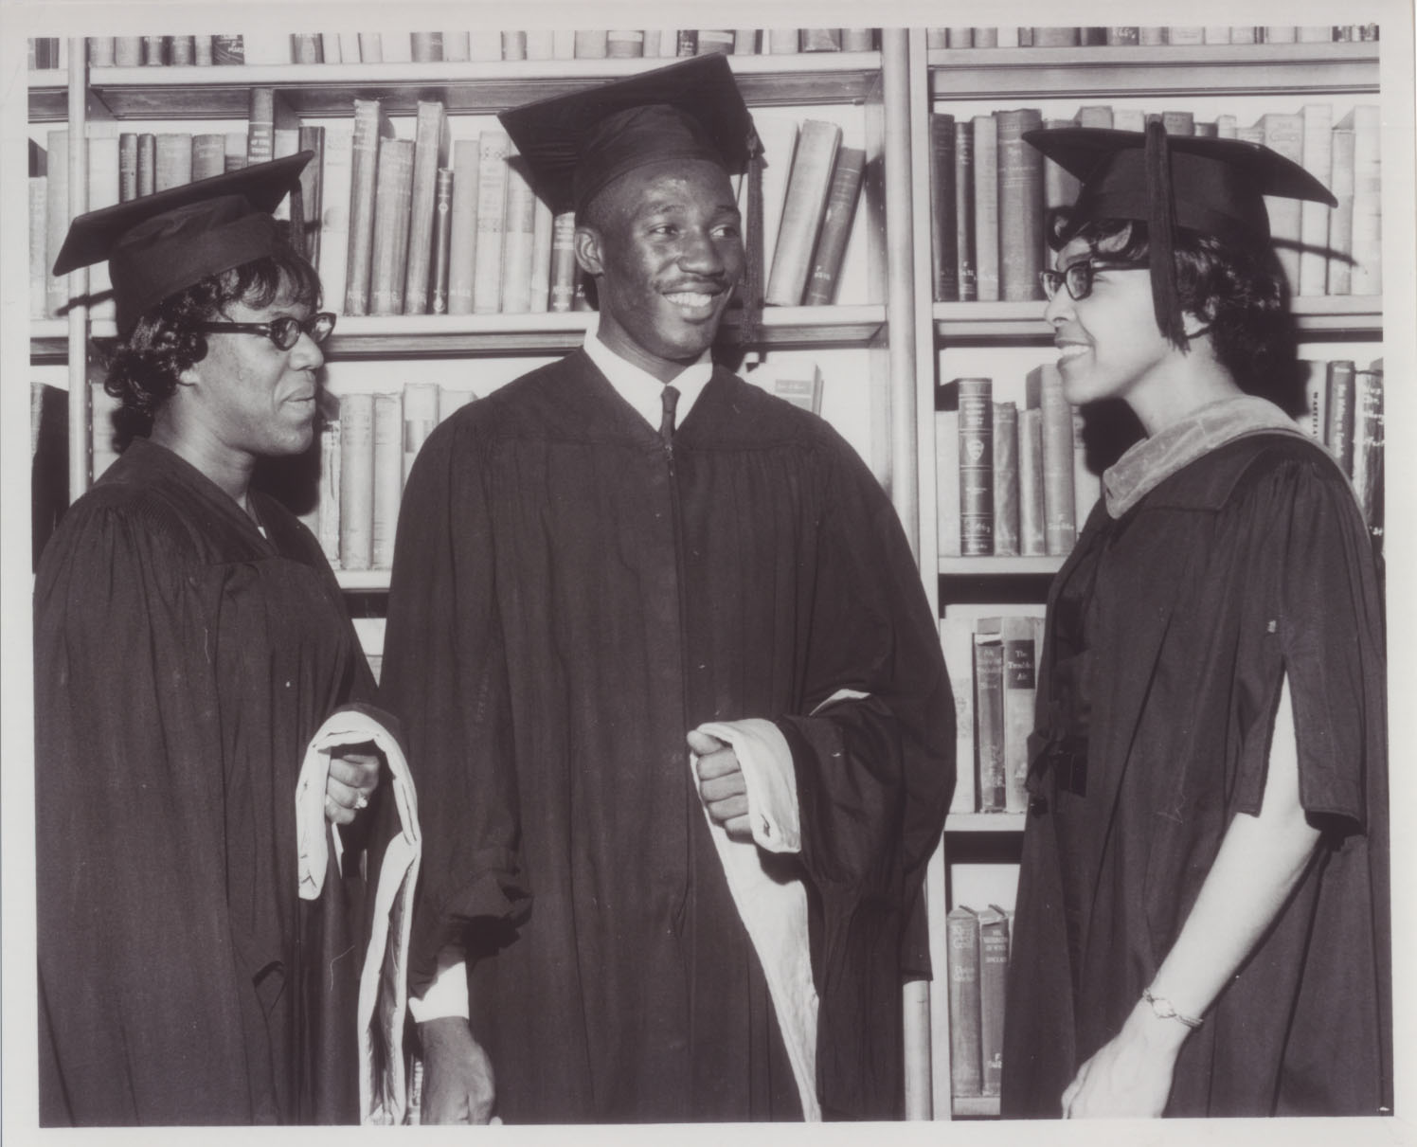
Ruth Coles Harris (right), Virginia, 1963
Dr. Ruth Coles Harris became the first African-American female CPA in Virginia in 1963, following in her sister Bernadine Coles Gines’s footsteps. For nearly five decades, she was a professor and department chair at Virginia Union University. Here’s an interview with her: https://soundcloud.com/wtju/ruth-coles

Slide 10
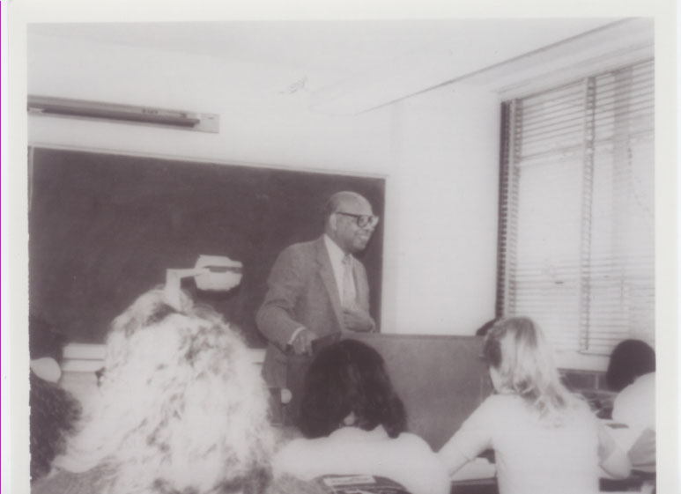
Talmadge C. Tillman Jr., California, 1965
Talmadge “Tab” Tillman was the first African-American graduate of the MBA program at Syracuse University. He earned his Ph.D. from the University of Southern California in 1967, and taught at Cal State Long Beach.

Slide 11
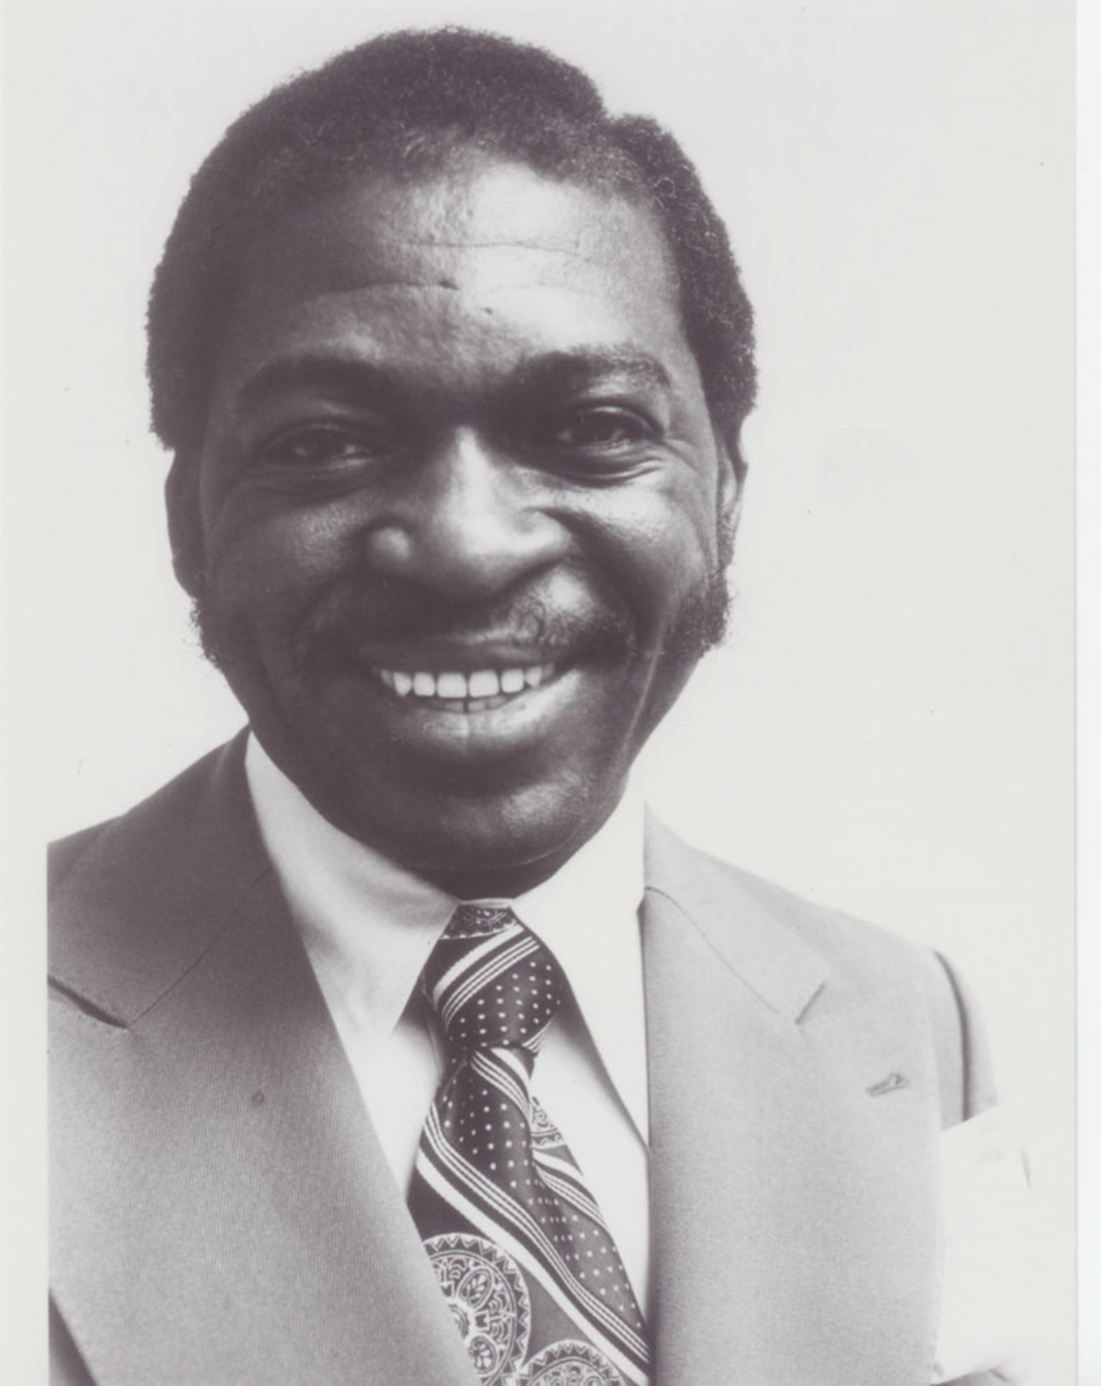
Bert N. Mitchell, New York, 1965
Bert N. Mitchell became the 100th African-American CPA in 1965. He founded the country’s largest Black-owned CPA firm, Mitchell & Titus LLP, which celebrates its 45th anniversary this year. In 1969, the Journal of Accountancy published his study of African-American CPAs, reporting that out of 100,000 CPAs in the United States, fewer than 150 were African-American. His firm has been a leader in expanding opportunity to African Americans in the profession.

Slide 12
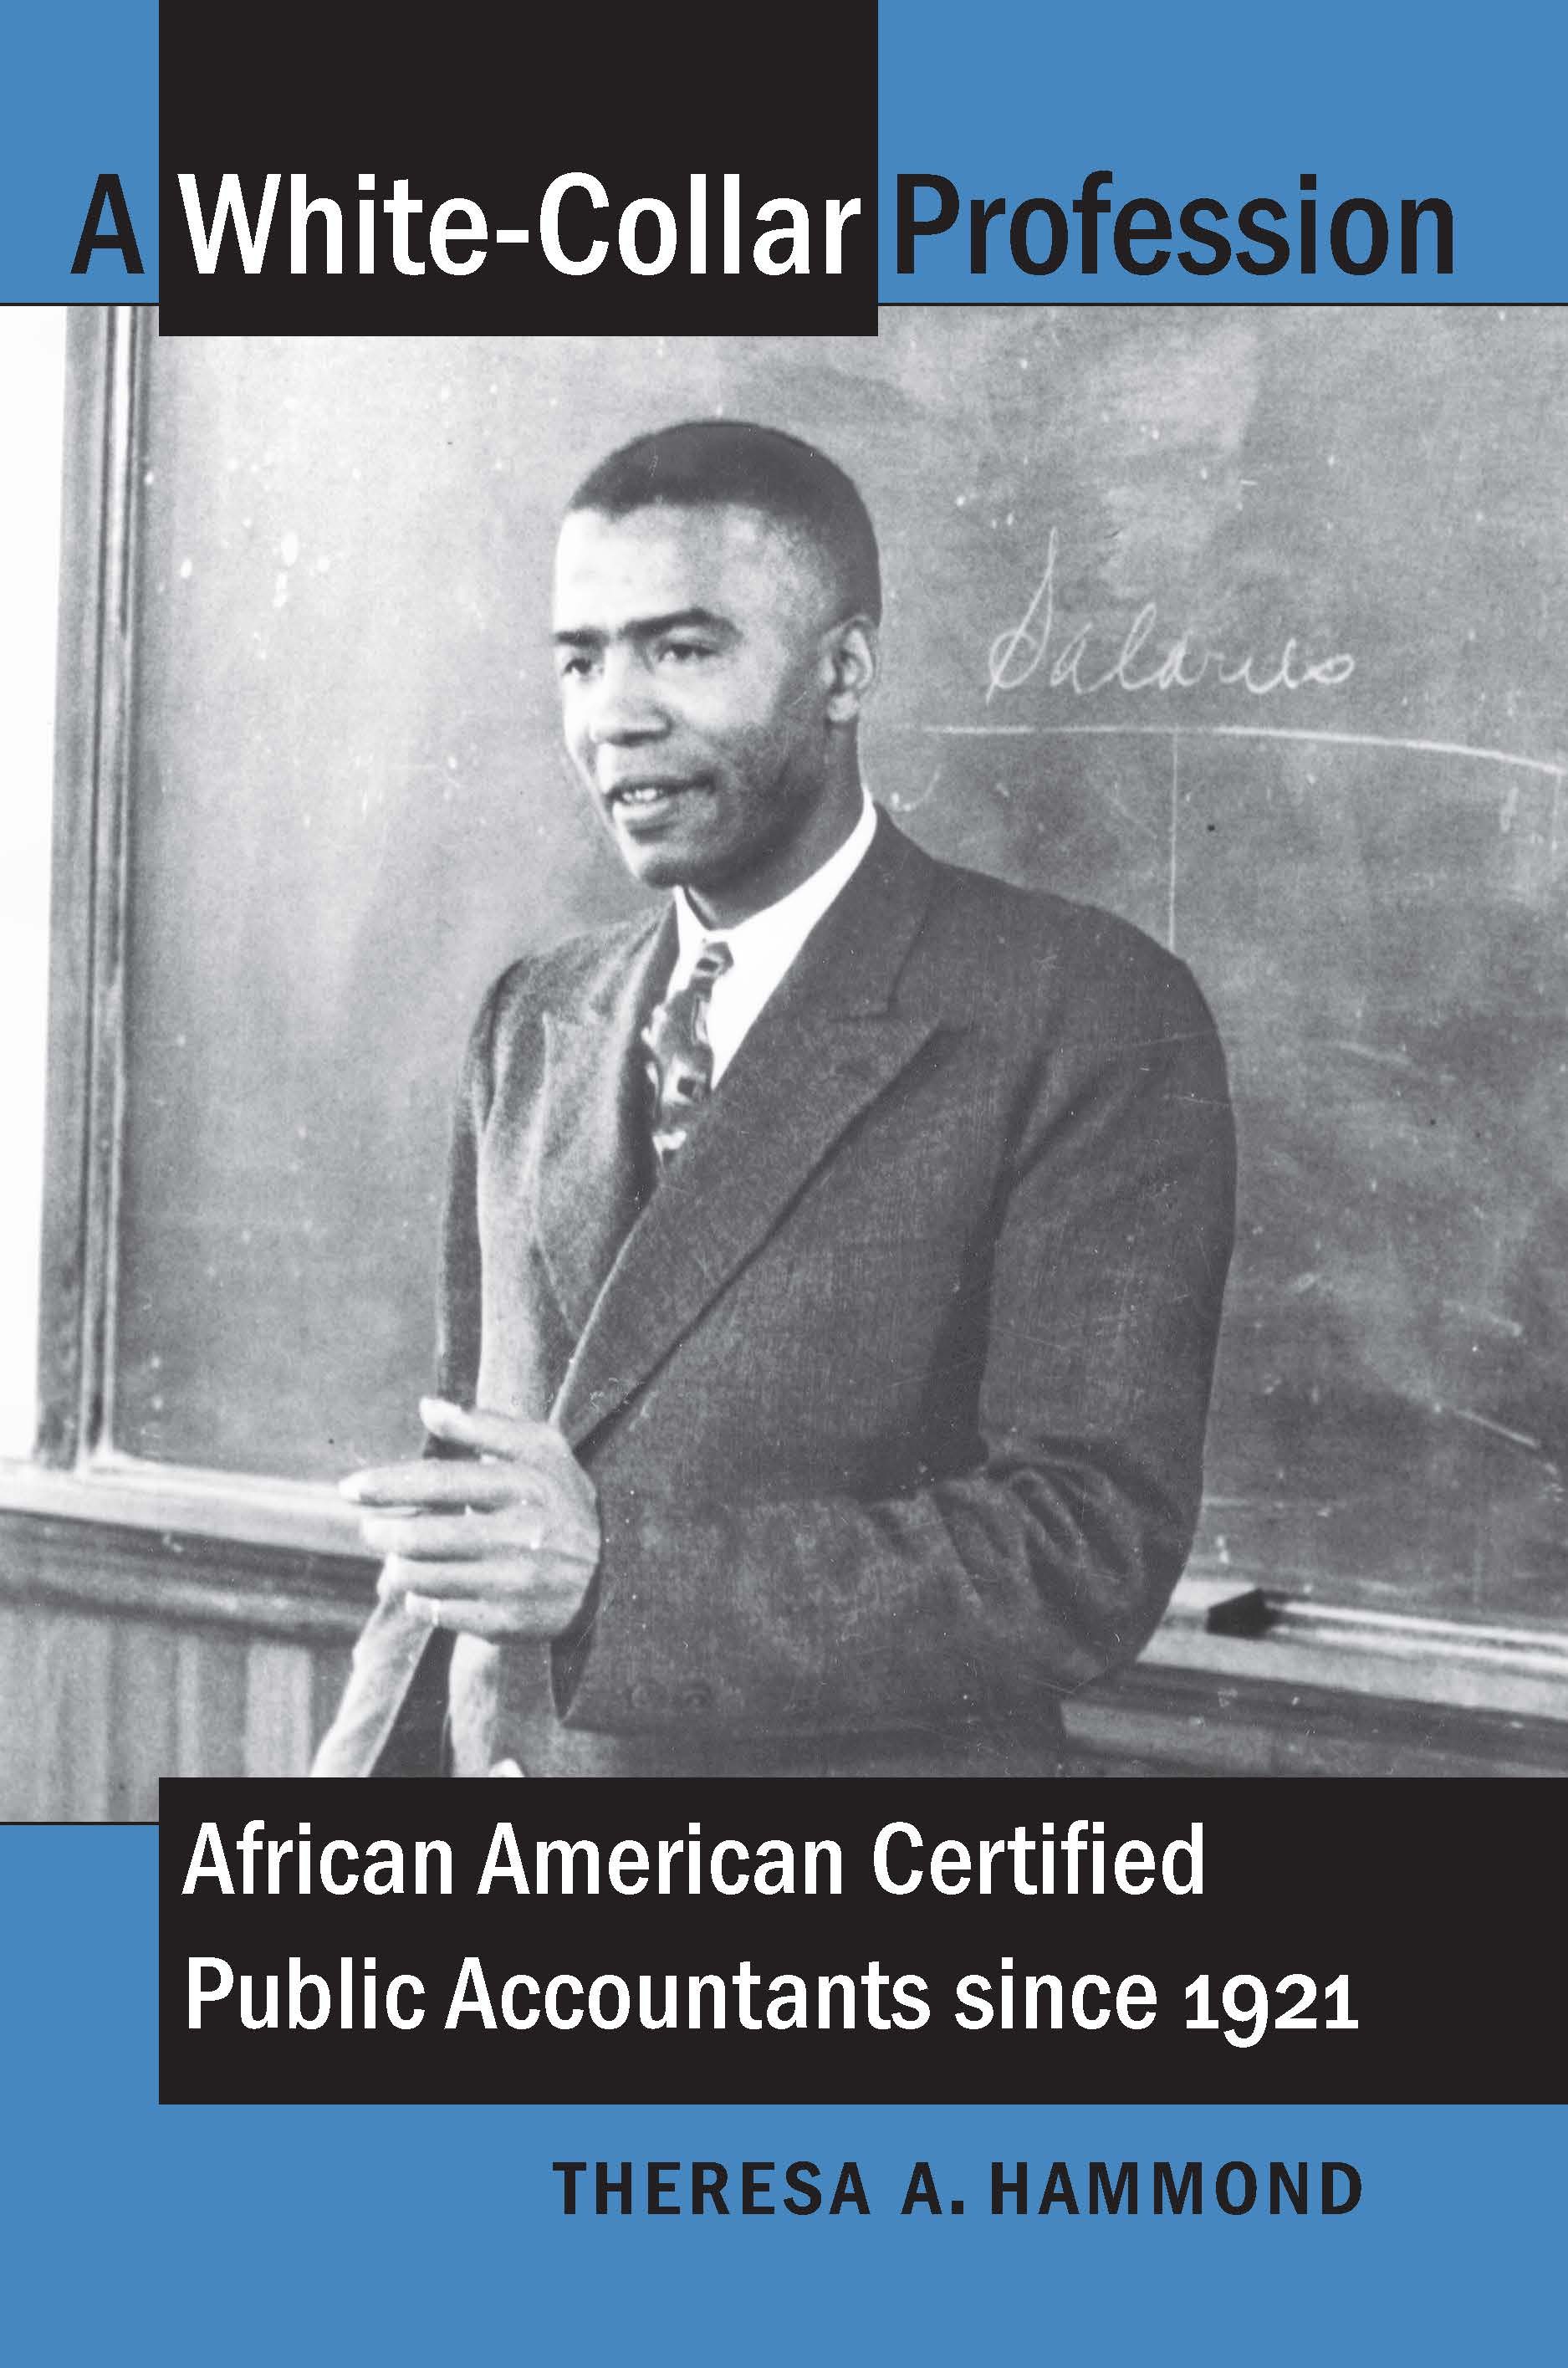
For more on the history of Black CPAs, the book is available from University of North Carolina Press. All royalties are donated to the National Association of Black Accountants.

